Slide 1
Introduction to TCP/IP
Lecture 21
CT4005NI - Computer Hardware and Software
Architectures

Slide 2
Introduction to TCP/IP
TCP/IP (Transmission Control Protocol / Internet Protocol) was created by DOD.
Computer Networks uses this TCP/IP schemes for Internetwork communication.
TCP/IP first came on the scene in 1973, but was later divided into two distinct protocols, TCP and IP.
In 1983, TCP/IP replaced NCP and was the authorized set of rules for data transmission over a computer network.

Slide 3
TCP/IP and the OSI Model
TCP/IP model is a condensed version of the OSI reference model.
It has four layers instead of the seven layers of the OSI model.
The four layers are Application/Process layer, Host-to-host or the Transport layer, the Internet or the Network layer and the Network Access Layer.

Slide 4
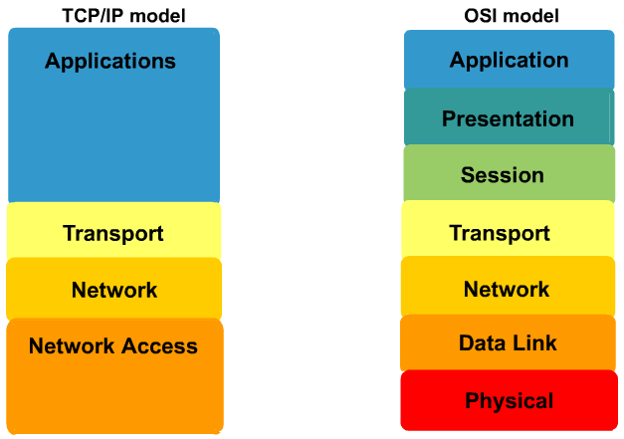
TCP/IP and the OSI Model

Slide 5
TCP/IP and the OSI Model
The Process/Application layer defines protocols for node to node application communication and also controls user interface specifications.
The Host-to-host or transport layer parallels the function of the OSI’s Transport layer by setting up transmission service for applications.
The Internet or Network layer corresponds to the OSI’s Network Layer, looking over the logical transmission of packets.
The Network Access layer implements the data exchange between the host and the network using hardware addressing.

Slide 6
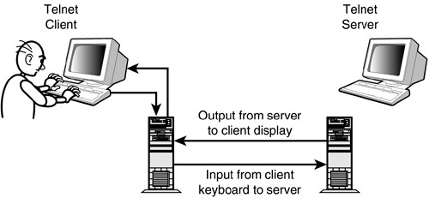
The Process/Application Layer Protocols
In the following sections, we will now cover the different Application Layer protocols used in an IP network.
1. TELNET: Used for terminal emulation and has a telnet client and a telnet server. Uses TCP port 23.

Slide 7
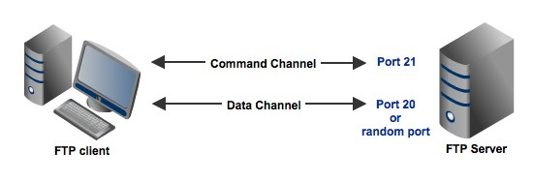
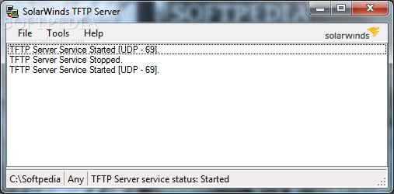
The Process/Application Layer Protocols
2. FTP: A protocol that allows us to transfer files. Requires proper authentication modes set up. TCP port 20 and 21.
3. TFTP: A stripped-down version of FTP that is mainly used for quick backups of data. Uses UDP port 69.

Slide 8
The Process/Application Layer Protocols
SMTP: Simple Mail Transfer Protocol (SMTP) is used to send mail using a spooled or queued method of mail delivery. Uses port 25.
POP and POP3: The Post Office Protocol (POP) is used to
retrieve mail from a mail server to a host. Uses port 110.
IMAPv4: Internet Message Access Protocol (IMAP) gives us more security while allowing users to retrieve mail from a mail server to a host. Uses port 143.

Slide 9
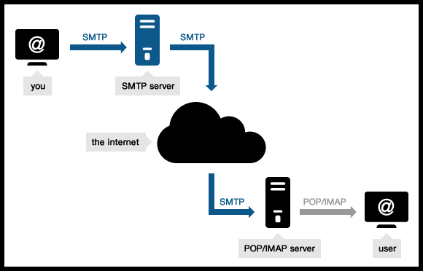
The Process/Application Layer Protocols

Slide 10
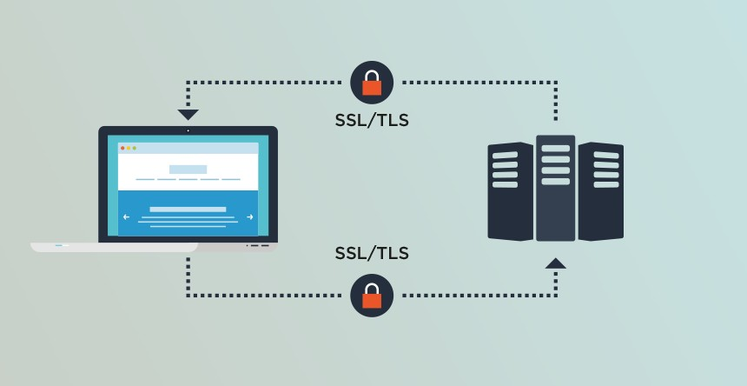
The Process/Application Layer Protocols
7. TLS and SSL: Transport Layer Security (TLS) and Secure Socket Layer (SSL) are cryptographic protocols or securing the online data transmission.

Slide 11
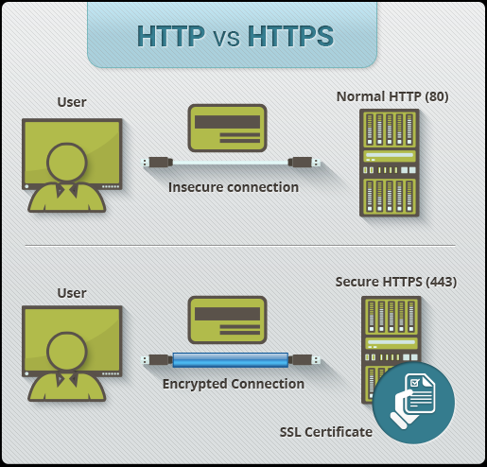
The Process/Application Layer Protocols
8.HTTP and HTTPS: Used to manage communications between browsers and servers. HTTPS uses SSL. HTTP is on TCP port 80 and HTTPs in 443.

Slide 12
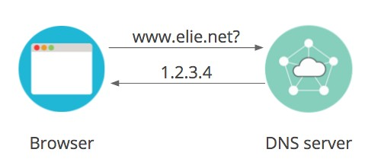
The Process/Application Layer Protocols
9. DNS: Domain name server (DNS) resolves hostnames. It uses port 53.

Slide 13
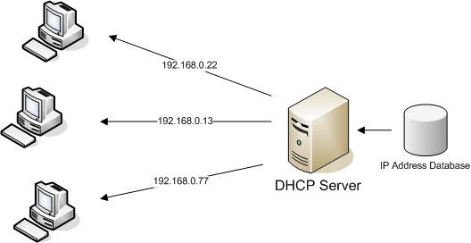
The Process/Application Layer Protocols
10. DHCP: Used to dynamically assign IP addresses to hosts.

Slide 14
Host-to-Host Layer Protocols
There are two sets of protocols in this layer which helps to manage end to end communication between the communicating hosts.
TCP
or Transmission Control Protocol is a Connection-
Oriented protocol.
UDP
or User Datagram Protocol is a Connection-Less
Protocol.

Slide 15
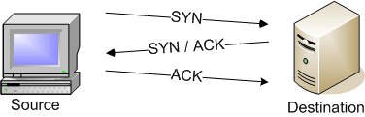
Host-to-Host Layer Protocols
TCP takes data from the top layer and then breaks it into segments.
Uses virtual circuits.
It sequences and numbers each segments and thus is called connection oriented protocol.
Uses Three-way-Handshake for reliability and is known as Reliable protocol.

Slide 16
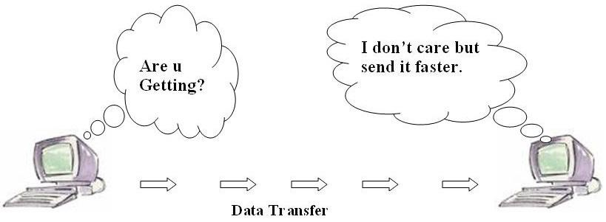
Host-to-Host Layer Protocols
UDP is a scaled down protocol and is also referred to as the thin protocol.
This protocol is used when the reliability of the transmitted data is not a priority.
The segments created using UDP are not segmented, nor numbered, hence known as Connectionless protocol.
There are no acknowledgements and thus the protocol is known as Unreliable protocol.

Slide 17
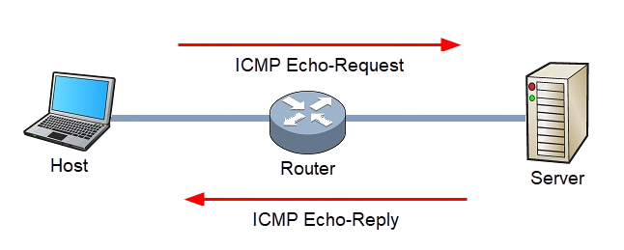
Network Layer
ICMP (Internet Control Message Protocol) is a protocol used to test devices connectivity in a network.

Slide 18
Port Numbers
Port
numbers are used for establishing communication
sessions and for communication with the upper layers to that of Host-to-Host layer.
There are source ports and then there are destination ports.
Numbers below 1024 are reserved as ports used by well known protocol and services.
1024 to 65535 can be used to make up source ports or destination ports.

Slide 19
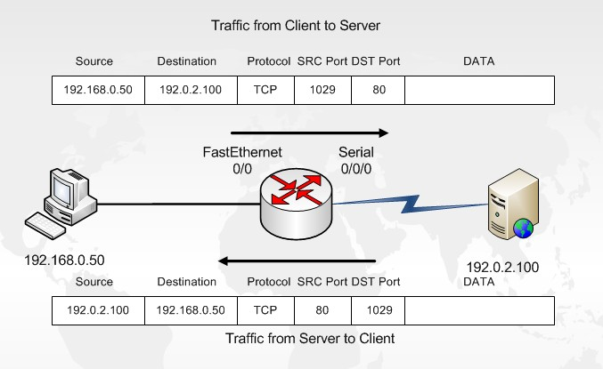
Port Numbers

Slide 20
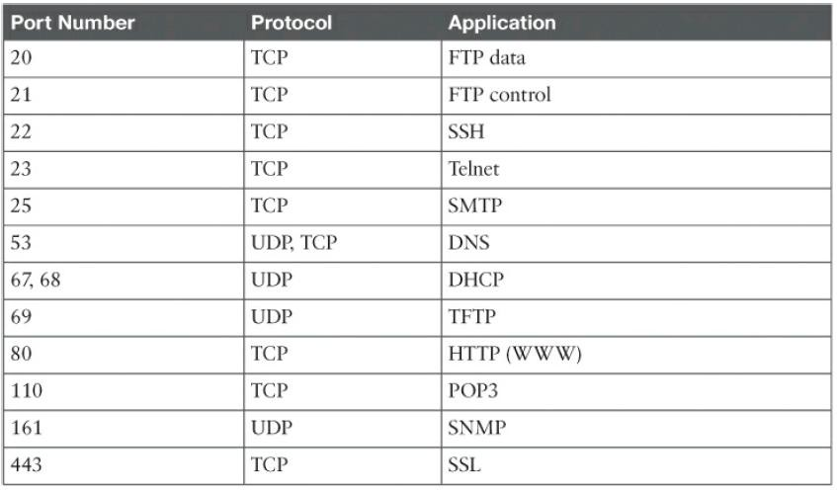
Common Port Numbers

Slide 21
Ethernet Cabling
There are generally three types of cables, Straight-through cable, Crossover cable and Rolled cable.
Straight-through cables are used to connect dissimilar devices together, maybe a host to switch or hub and a router to switch or hub.
Crossover cables are used to connect similar devices together, maybe a switch to a switch or a hub to another hub, host to a host.
Rollover cables are used to connect a host to a router’s console COM port for router configuration.

Slide 22
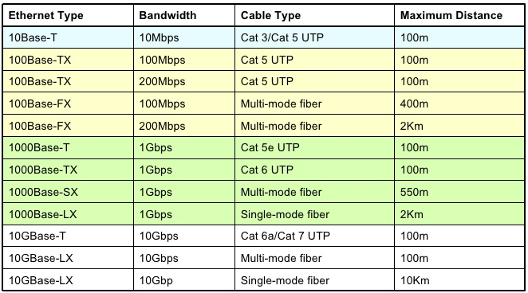
Common Ethernet Cables

Slide 23
End of Lecture 21

